Slide 1
Recitation 1
Mini Lecture

Slide 2





About Me
Name : Hyungjoo Choi
Originally from Korea
Education
B.S. in Naval Architecture and Ocean Engineering – Exchange Student at Murray State University in KY
M.S. in Civil/Material Engineering at University of Alabama in Huntsville
M.S. in Civil/Structural Engineering at Iowa State University
Obtaining Ph.D at Rutgers in Civil/Structural Engineering

Slide 3
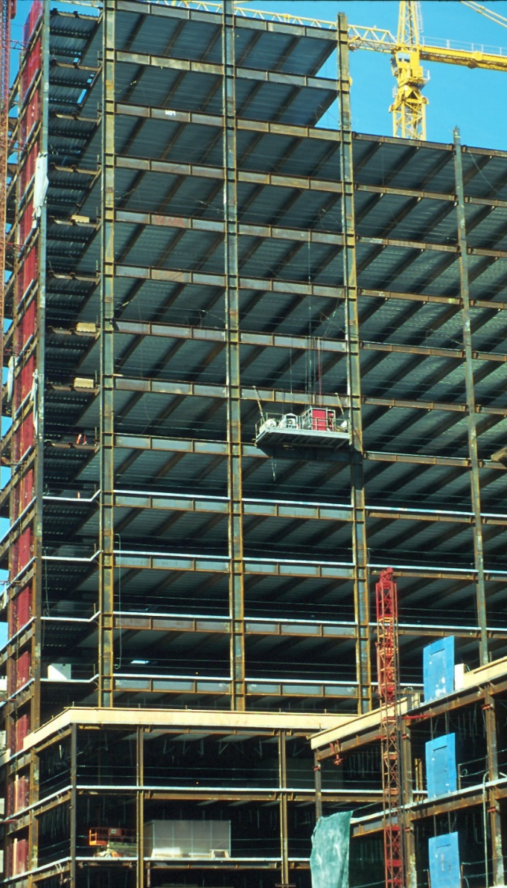

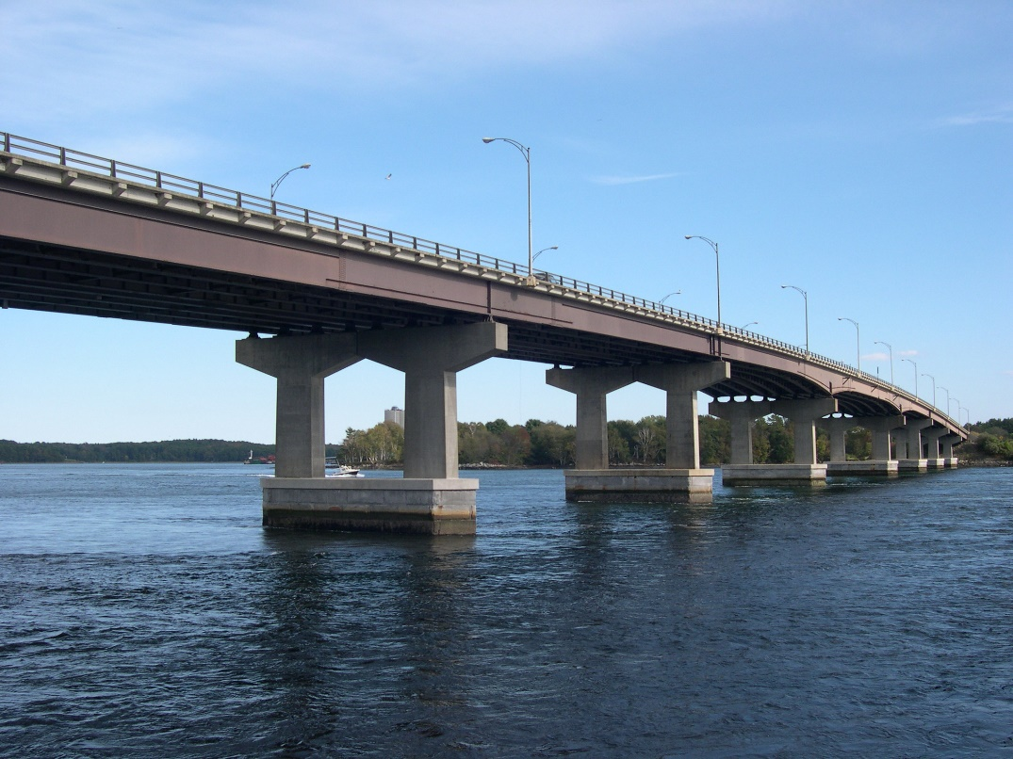
About Me – Structural Engineer

Slide 4
Course Meeting Times
Section Number | Recitation Day | Recitation Time | Recitation Instructor | Recitation Room | Lecture Day | Lecture Time | Lecture Room
1 | Monday | 10:20AM | Prof. Brown | BST-111 | Tuesday | 5:00PM | ARC-103
2 | Monday | 12:00PM | A. Abas | BST-111 | Tuesday | 5:00PM | ARC-103
3 | Monday | 1:40PM | A. Abas | BST-111 | Tuesday | 5:00PM | ARC-103
4 | Monday | 5:00PM | S. Tsianikas | BST-111 | Tuesday | 5:00PM | ARC-103
5 | Tuesday | 12:00PM | S. Rupavatharam | BST-111 | Tuesday | 5:00PM | ARC-103
6 | Tuesday | 1:40PM | H. Choi | BST-111 | Tuesday | 5:00PM | ARC-103
7 | Wednesday | 10:20AM | N. Cuitino | BST-111 | Tuesday | 5:00PM | ARC-103
8 | Wednesday | 1:40PM | R. Li | BST-111 | Tuesday | 5:00PM | ARC-103
9 | Wednesday | 5:00PM | I. Liberis | BST-111 | Wednesday | 12:00PM | ARC-103
10 | Thursday | 10:20AM | S. Rupavatharam | BST-111 | Wednesday | 12:00PM | ARC-103
11 | Thursday | 12:00PM | N. Cuitino | BST-111 | Wednesday | 12:00PM | ARC-103
12 | Thursday | 1:40PM | H. Choi | BST-111 | Wednesday | 12:00PM | ARC-103
14 | Friday | 10:20AM | S. Tsianikas | BST-111 | Wednesday | 12:00PM | ARC-103
15 | Friday | 12:00PM | R. Li | BST-111 | Wednesday | 12:00PM | ARC-103
16 | Friday | 1:40PM | I. Liberis | BST-111 | Wednesday | 12:00PM | ARC-103
Office Hours: Tuesday 3:00-4:00 PM Thursday 3:00-4:00 PM
At
School of Engineering Building room B114A

Slide 5
Recitation Assignments
10 Recitation assignments
Due within 72 hours of recitation
25% of grade
Must attend recitation to receive a grade
Additional penalty to course grade for missing recitation
Individual vs. Collaboration (Up to 5 students)

Slide 6
You can do math with binary numbers!
Same rules as base 10, just in base 2!
3
+ 4
011
+ 100
011
+ 100
111
3
+ 4
7
Value carries
2
+ 3
010
+ 011
010
+ 011
1
1
010
+ 011
01
010
+ 011
101
2
+ 3
5
...But the negative value moves over to next digit
-1
-1
6
- 1
110
- 001
110
- 001
1
110
- 001
01
110
- 001
101
6
- 1
5
0 – 1 results in a 1...
Notes:
Walk students through these or similar examples. Make explicit note of the fact that numbers have to carry over to lead into the next slide.

Slide 7
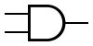
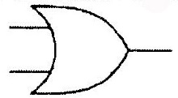
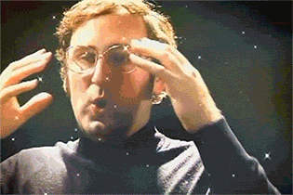
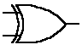
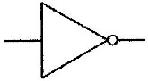
The math is a bit more complicated for computers...
All math in computers needs to be accomplished via “logic gates”
AND OR
XOR NOT
Bit1 | Bit2 | Bit1 AND Bit2
0 | 0 | 0
1 | 0 | 0
0 | 1 | 0
1 | 1 | 1
Bit1 | Bit2 | Bit1 OR Bit2
0 | 0 | 0
1 | 0 | 1
0 | 1 | 1
1 | 1 | 1
Bit1 | Bit2 | Bit1 OR Bit2
0 | 0 | 0
1 | 0 | 1
0 | 1 | 1
1 | 1 | 0
Bit1 | NOT Bit2
0 | 1
1 | 0
All other computer operations are really just cominations of these!!!
Notes:
These are the logical commands (along with their inverses) that can be built with transistors. While most logic gates now just use a large combination of NAND gates (NOT AND) due to the simplicity of components for building that, the overall concept on this slide is still true. While humans can think abstractly and do things like carry numbers, computers have to build abstraction from basic units (like with bits and representing data).

Slide 8
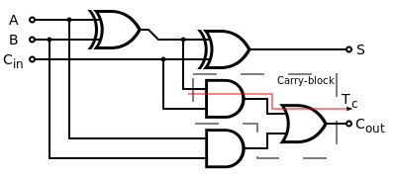
What does that look like?
Two bit full adder
By inductiveload - Own drawing, Inkscape 0.43, Public Domain, https://commons.wikimedia.org/w/index.php?curid=1023334

Slide 9
The good news
Computers are really good at sending numbers through those gates quickly
While it seems more complicated for humans to add things up this way, computers do it in almost no time!

Slide 10
Recall from lecture
There are different systems for storing different kinds of data
Some kinds of data have multiple systems for storage
Example: Signed Integers
Notes:
Have a sentence or two that connects this slide and topic with logic gates

Slide 11
One’s Compliment vs Two’s Compliment
One’s Compliment
Two’s Compliment
Leftmost bit is sign
Negative numbers count “down” from all 1’s
1111 = -0
1110 = -1
1101 = -2
Positive numbers count normally
Leftmost bit is sign
Negative numbers count “down” from all 1’s
1111 = -1
1110 = -2
1101 = -3
Positive numbers count normally

Slide 12
Why two different systems?
Early computer systems used one’s compliment
Engineers figured out that two’s compliment arithmetic was the same as signed integer arithmetic
Saves resources in many ways
Many old systems were already the basis for subsequent systems
One’s compliment stuck around
Most modern computers use two’s compliment now

Slide 13
Today
We’ll think about different systems for storage
Numbers
Characters
We will write some very basic code in MATLAB to get used to using it

